Slide 1



Amazon Web Services 101

Slide 2
AWS Introduction
Why are enterprises choosing AWS?
What are enterprises using AWS for?
How are enterprise getting started with AWS?

Slide 3
AWS Provides Broad and Deep Services to Support Any Cloud Workload
Deployment & Administration
Application Services
Compute
Storage
Database
Networking
AWS Global Infrastructure

Slide 4
AWS Rapid Pace of Innovation
+280
Since inception AWS has:
Released 896 new services and features
Introduced over 35 major new services
Announced 44 price reductions
+159
+82
+61
Amazon Elastic
Transcoder
+239
AWS Storage
Gateway
+48
Amazon SES
Amazon
Dynamo DB
AWS OpsWorks
AWS Elastic
Beanstalk
Amazon
CloudHSM
Amazon Cognito
Amazon
CloudSearch
Amazon Mobile
Analytics
+24
AWS
CloudFormation
Amazon
AppStream
Elastic Load
Balancing
Amazon SNS
Amazon SWF
Amazon Zocalo
Amazon
ElastiCache
Amazon
CloudTrail
AWS Identity
& Access
Management
Amazon Glacier
Auto Scaling
Amazon Redshift
Amazon EBS
AWS Direct
Connect
Amazon
WorkSpaces
Amazon
CloudFront
Amazon VPC
AWS Data
Pipeline
Amazon RDS
Amazon Route 53
GovCloud
Amazon Kinesis
2008
2009
2010
2011
2012
2013
2014
*as of July 12, 2014

Slide 5
239
New features in
2014 so far including …
Amazon AppStream available to all customers
March 12, 2014
33
24
35
March 2014
Amazon WorkSpaces available to all customers
March 26, 2014
Jan 2014
Feb 2014
34
56
38
Introduced T2, the New Low-Cost, General Purpose Instance Type for Amazon EC2
July 1, 2014
April 2014
May 2014
June 2014
19
Introduced Amazon Mobile Analytics
July 10, 2014
July 2014
Aug 2014
Sept 2014
Introduced Amazon Zocalo
July 10, 2014
Oct 2014
Nov 2014
Dec 2014
*as of July 12, 2014

Slide 6
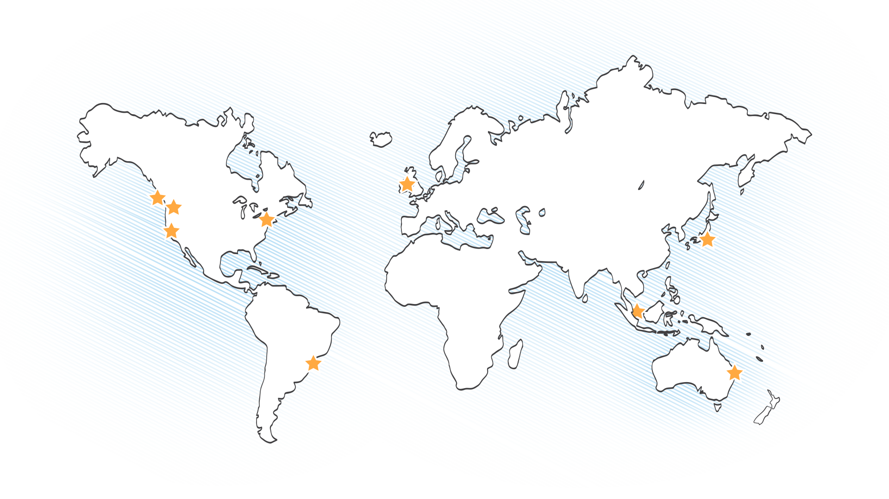
AWS Global Infrastructure
10 Regions*
26 Availability Zones*
53 Edge Locations
*China (Beijing) Region – in limited preview
Notes:
Our data center footprint is global, spanning 5 continents with highly redundant clusters of data centers in each region. Our footprint is expanding continuously as we increase capacity, redundancy and add locations to meet the needs of our customers around the world.

Slide 7




















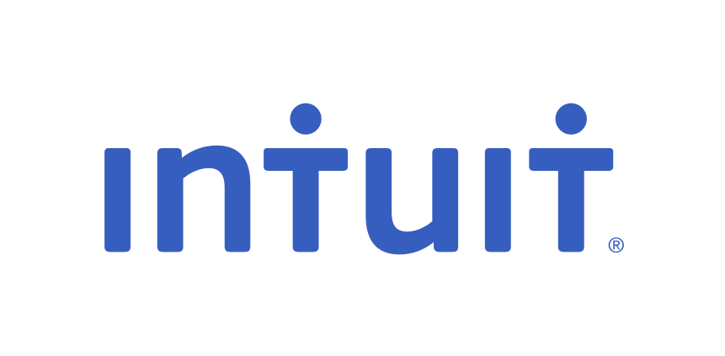




Trusted by Enterprises Around the World
Notes:
AWS is solving problems for big organizations across many Verticals and geographies. We’re extremely proud of our customer list and happy to know that we’re providing good outcomes and better results for some of the best firms in the world

Slide 8
























Used by Government Agencies & Educational Institutions Worldwide

Slide 9
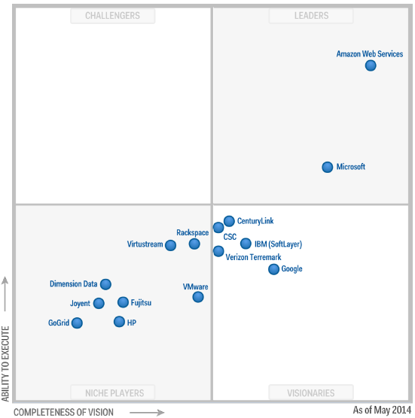

“AWS is the overwhelming market share leader, with more than five times the compute capacity in use than the aggregate total of the other fourteen providers.”
Source: Gartner (May 2014)
Gartner “Magic Quadrant for Cloud Infrastructure as a Service,” Lydia Leong, Douglas Toombs, Bob Gill, Gregor Petri, Tiny Haynes, May 28, 2014. This Magic Quadrant graphic was published by Gartner, Inc. as part of a larger research note and should be evaluated in the context of the entire report.. The Gartner report is available upon request from Steven Armstrong (asteven@amazon.com). Gartner does not endorse any vendor, product or service depicted in its research publications, and does not advise technology users to select only those vendors with the highest ratings. Gartner research publications consist of the opinions of Gartner's research organization and should not be construed as statements of fact. Gartner disclaims all warranties, expressed or implied, with respect to this research, including any warranties of merchantability or fitness for a particular purpose.

Slide 10
AWS Introduction
Why are enterprises choosing AWS?
What are enterprises using AWS for?
How are enterprise getting started with AWS?

Slide 11


Lower Costs with AWS Up-Front and Increase Savings as Your Usage Grows
1
2
3
4
Replace up-front capital expense with low variable cost
Economies of scale have allowed us to consistently lower costs
Pricing model choice to support variable & stable workloads
Save more money as you grow bigger
“Average of 400 servers replaced per customer”
44 Price Reductions
On-demand
Tiered Pricing
Reserved
Volume Discounts
Spot
Source: IDC Whitepaper, sponsored by Amazon, “The Business Value of Amazon Web Services Accelerates Over Time.” July 2012

Slide 12
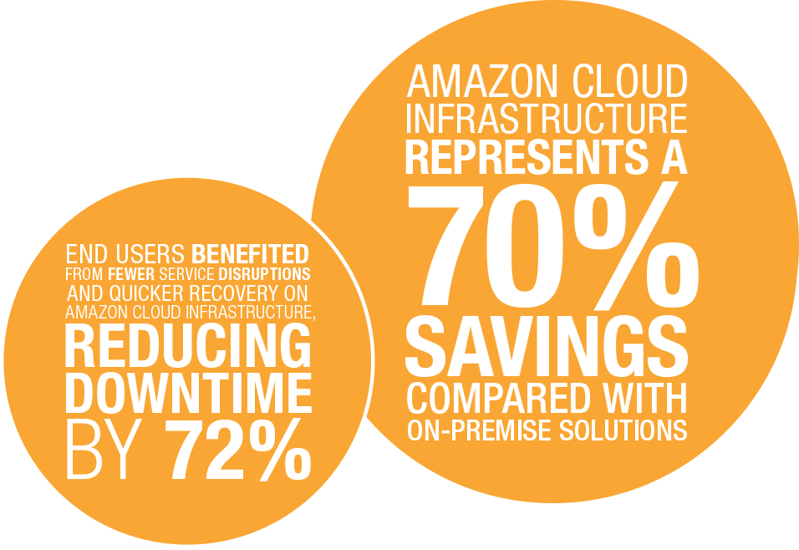
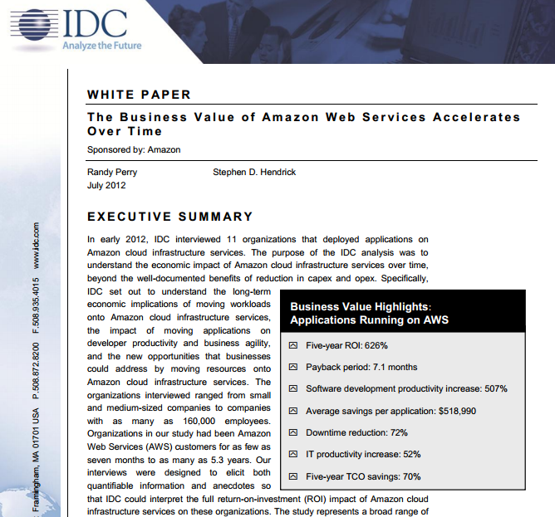

4X More Reliable & 1/4 the Cost of On-Premises Infrastructure
“Source: IDC Study. In early 2012, AWS commissioned IDC to interview 11 organizations that deployed applications on AWS.”
Notes:
Amazon sponsored a study by IDC where they interviewed a group of our customers to get a sense of the results they get from using AWS. The results were quite favorable, with the aggregate numbers showing significant cost savings, combined with better results in terms of reduced downtime. We’re proud to deliver both benefits simultaneously- that we don’t sacrifice quality to reduce costs, and are most proud that our customers can demonstrate the benefits. We encourage you to read this full report to get the full details- it’s available on our website.

Slide 13











Architected for Enterprise Security Requirements
Certifications and accreditations for workloads that matter
AWS CloudTrail - AWS API call logging for governance & compliance
Log and review user activity
Stores data in Amazon S3, or archive to Amazon Glacier
Notes:
You might have questions about security in the cloud, but our biggest and most conservative customers have found that we’re able to meet their security requirements, and often we can provide a better security profile than what they can deliver internally. Our focus and investment in security, and the fact that we incorporate requirements from our most security conscious customers which then benefit all of the customers on our platform allows us to offer an effective approach to meeting enterprise security requirements. We encourage you to dig deeper with our security white paper, and would be happy to help you get the information you need to feel confident in our security capabilities and options.

Slide 14


Increased agility has become the #1 reason businesses use the AWS cloud

Slide 15

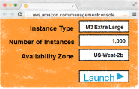
Enterprises Can’t Afford to be Slow
Old World:
Infrastructure in Weeks
AWS:
Infrastructure in Minutes
Add New Dev Environment
Add New Prod Environment
Add New Environment in Japan
Add 1,000 Servers
Remove 1,000 servers
Deploy 2 PB Data warehouse
Shut down 2 PB Data warehouse
Everything changes with this kind of agility
Notes:
no script

Slide 16


A Culture of Innovation: Experiment Often and Fail Without Risk
$ Millions
On-Premises
Experiment Infrequently
Failure is expensive
Less Innovation
Low Cost
Experiment Often
Fail quickly at a low cost
More Innovation
Notes:
We see our customers do amazing things when they reduce the cost of experimentation- it moves IT from being a roadblock, where each idea costs lots of money and takes lots of time, to being an enabler where you can launch a speculative project quickly and cheaply. It allows firms to take more chances on ideas, and gives them a shot at winning big, as opposed to being scared to even try.

Slide 17




Many Enterprises Worry That These are the Only Two Choices
#1
#2
Build a “private” cloud
Rip everything out and move to AWS

Slide 18


The Good News is that Cloud isn’t an ‘All or Nothing’ Choice
On-Premises Resources
Cloud Resources
Integration
Corporate Data Centers

Slide 19

Integrating AWS with Your Existing On-Premises Infrastructure
Active Directory
Network Configuration
Encryption
Backup Appliances
Your On-Premises
Apps
Users & Access Rules (IAM)
Your Private Network (VPC)
Encryption (S3, RDS, HSM)
Backups (Storage Gateway)
Your Cloud Apps
Corporate Data Centers
AWS Direct Connect
Notes:
And these are some of the key products that support this vision of hybrid cloud

Slide 20
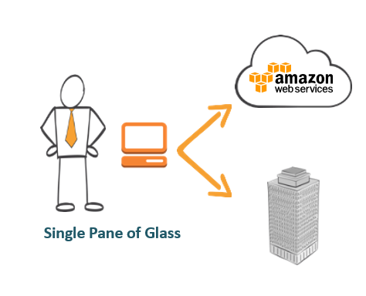
Tools to Help Customers Manage Resources Across Environments
Notes:
We envision a hybrid cloud that allows you to use existing management frameworks to manage resources consistently and move workloads seamlessly between your data center and our cloud as you need. Management tool Partners include: RightScale, Dell, CloudVelocity, Microsoft, Eucalyptus, Racemi, VMWare, bmcsoftware, Apprenda, Xceedium, Symantec, Market Simplified, and CA

Slide 21
AWS Introduction
Why are enterprises choosing AWS?
What are enterprises using AWS for?
How are enterprise getting started with AWS?

Slide 22

Enterprises Use Cases on AWS
Enterprise Apps and Dev./Test
Big Data and
HPC
Storage, Backup and Archival
Web, Mobile, and Social Apps
Disaster Recovery
Virtual Desktops

Slide 23




...Including Entire Data Center Migrations
Moved out of Hong Kong Data Center into AWS for all WSJ.com production traffic in Asia
Operations, finance and accounting, and training services in AWS today.
Moving entire infrastructure to AWS and closing its Geneva data center.
Currently running tens of thousands of servers on AWS.
25% of servers running on AWS with plans to exceed 75% within the next three years.

Slide 24



Enterprise Applications
Amazon RDS for Oracle provides managed Oracle database deployments
Oracle Applications are fully supported on AWS
Oracle licenses owned by customers are fully portable to AWS
AWS is an SAP-certified Global Cloud Services Partner and Global Technology Partner
Most SAP products are now certified for production deployment on AWS
Full, real, licensed Windows Server OS on AWS
Easily install services that you know - AD, ADFS, SCOM, SQL, Exchange, SharePoint etc.
Use your existing MS licenses on AWS using BYOL

Slide 25
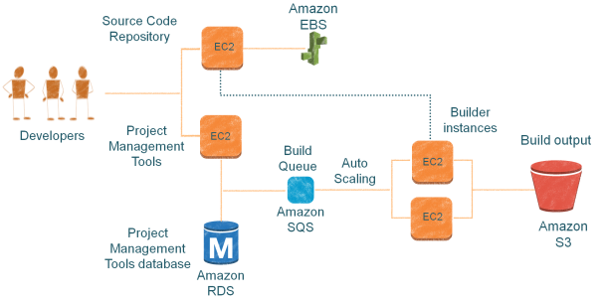
Development and Test Environments
AWS Dev./Test Scenarios
On-demand Dev. environments
On-Demand Builds
Automated Test environments
Load Testing

Slide 26
Big Data
Generation
Lower cost, higher throughput
Collection & storage
Close the gap.
Highly constrained
Analytics & computation
Collaboration & sharing
Technologies and techniques for working productively with data, at any scale
Elastic and highly scalable + No upfront CapEx + Only pay for what you use + Available on-demand = Remove constraints

Slide 27





Big Data
Amazon EMR (Elastic MapReduce)
Amazon Redshift
AWS Data Pipeline
Managed Hadoop
Service
Easily launch, customize, and resize your managed Hadoop cluster
Petabyte-scale data
warehouse service
More data among AWS
Services and on-premises data sources
Amazon Kinesis - Fully-managed service for real time processing of streaming data, at any scale.
Plug and play with a simple, pre-built client library
Deploy Amazon Kinesis-enabled applications to Amazon EC2
Integrates with Amazon Redshift, Amazon DynamoDB, Amazon EMR, and Amazon S3

Slide 28
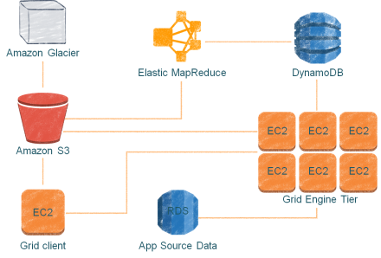
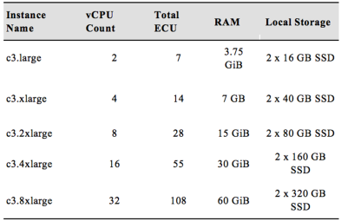
High Performance Computing (HPC)
C3 instances
Improved Network Performance
SSD based Platform

Slide 29






Storage, Backup, and Archival
On-premises Data Center
AWS Storage Gateway
Corporate File Sharing & seamless backup of enterprise data to Amazon S3
Block
File
Archive
Backup
Disaster Recovery
Amazon Elastic Block Store
Persistent Block Storage for EC2
Gateway Appliance/ AWS Storage Gateway
Amazon S3
Redundant, High-Scale Object Store
AWS Cloud
Amazon Glacier
Low-cost Archive Storage in the Cloud
Amazon EBS
Amazon S3
Amazon Glacier

Slide 30
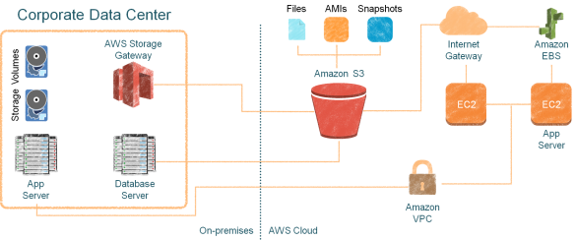





Disaster Recovery
AWS DR Scenarios Backup and Restore
Pilot Light for Simple Recovery into AWS
Warm Standby Solution
Multi-site Solution
Amazon RDS – Cross Region Read Replicas
Improved disaster recovery operations.
Readable copies for cross-region applications.
Easy migration between regions

Slide 31
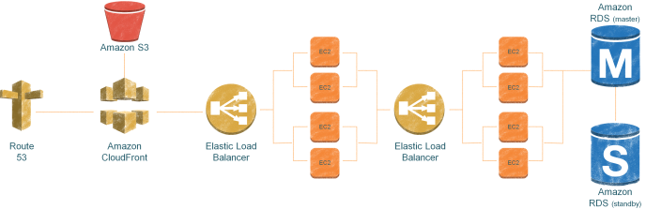
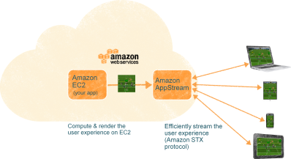
Web, Mobile, and Social Apps
Amazon AppStream
HD Video Quality Application Streaming
Captures user input to send back to the cloud. Responsive and consistent experience across devices

Slide 32




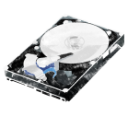
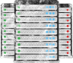



Amazon WorkSpaces
Virtual Desktops - Half the Price of On-Premises VDI
No hardware or virtualization software
Access through browser or tablet device
Monthly pricing—no long-term commitments
License software from us or bring your own licenses
Easy integration with MS Active Directory
No Server Hardware
No Storage Infrastructure
No VDI Software
No VDI Administration
X
X
X
X
Notes:
AppStream allows you to easily deliver low-cost virtual desktops that are secure, centrally managed and connected to your internal systems

Slide 33
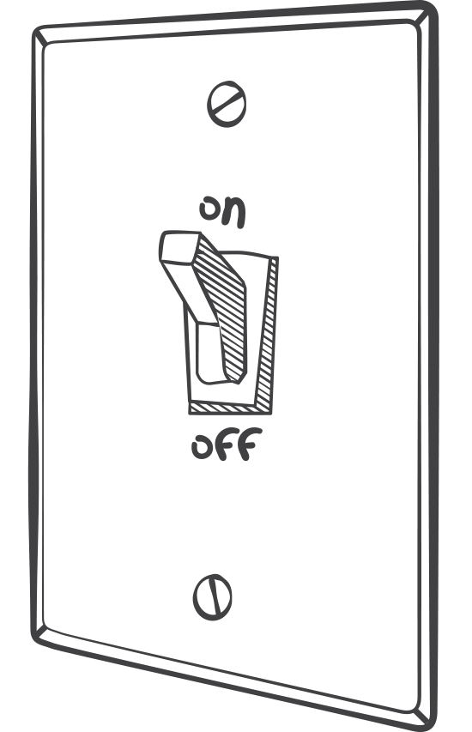
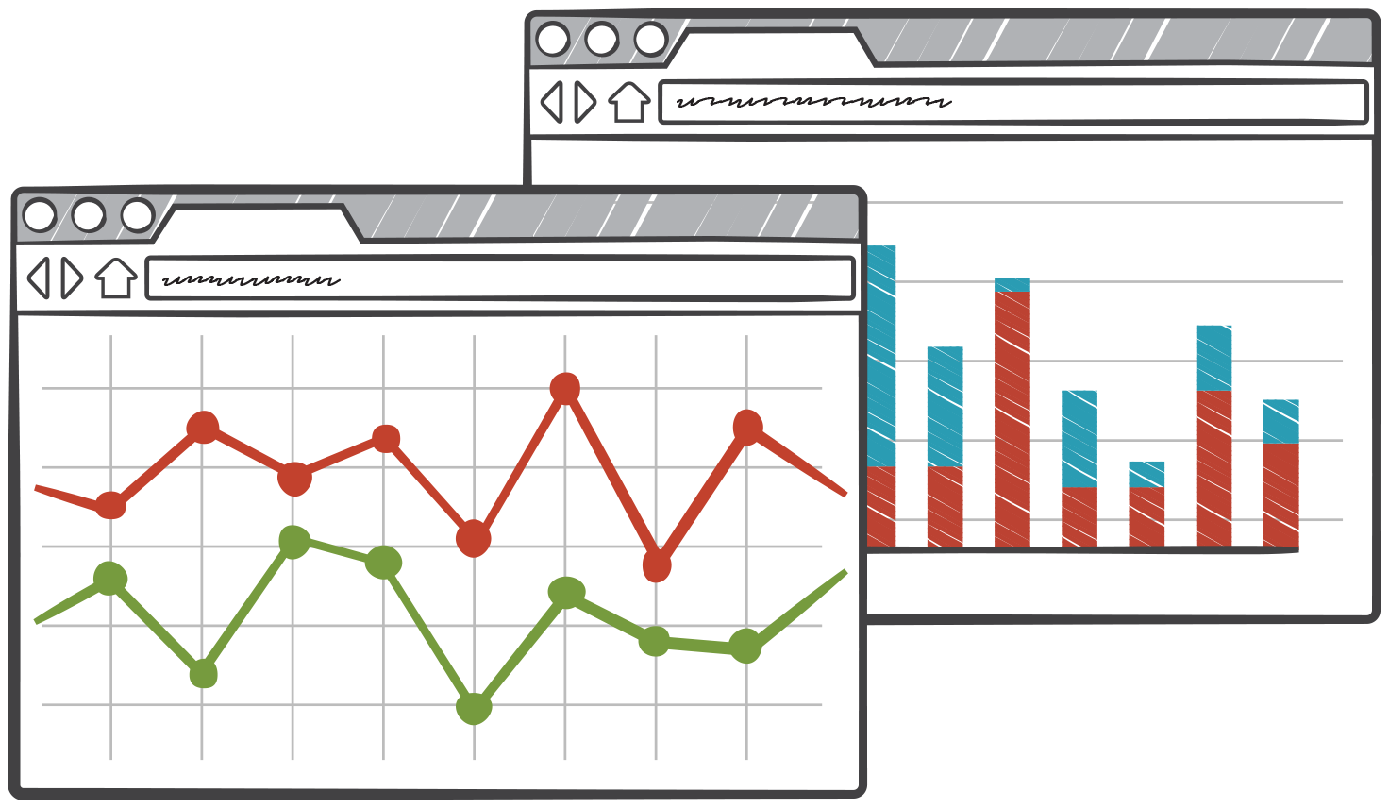

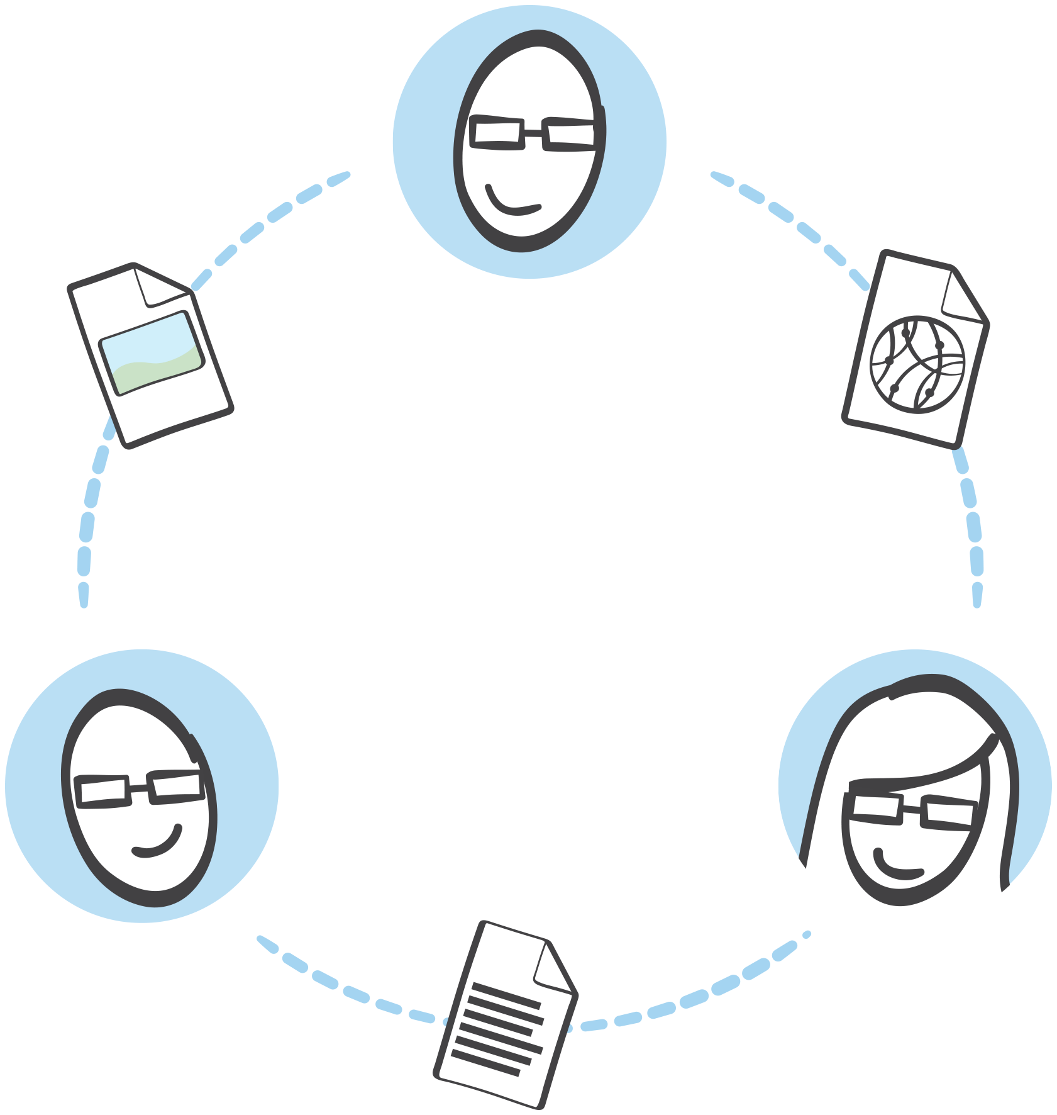

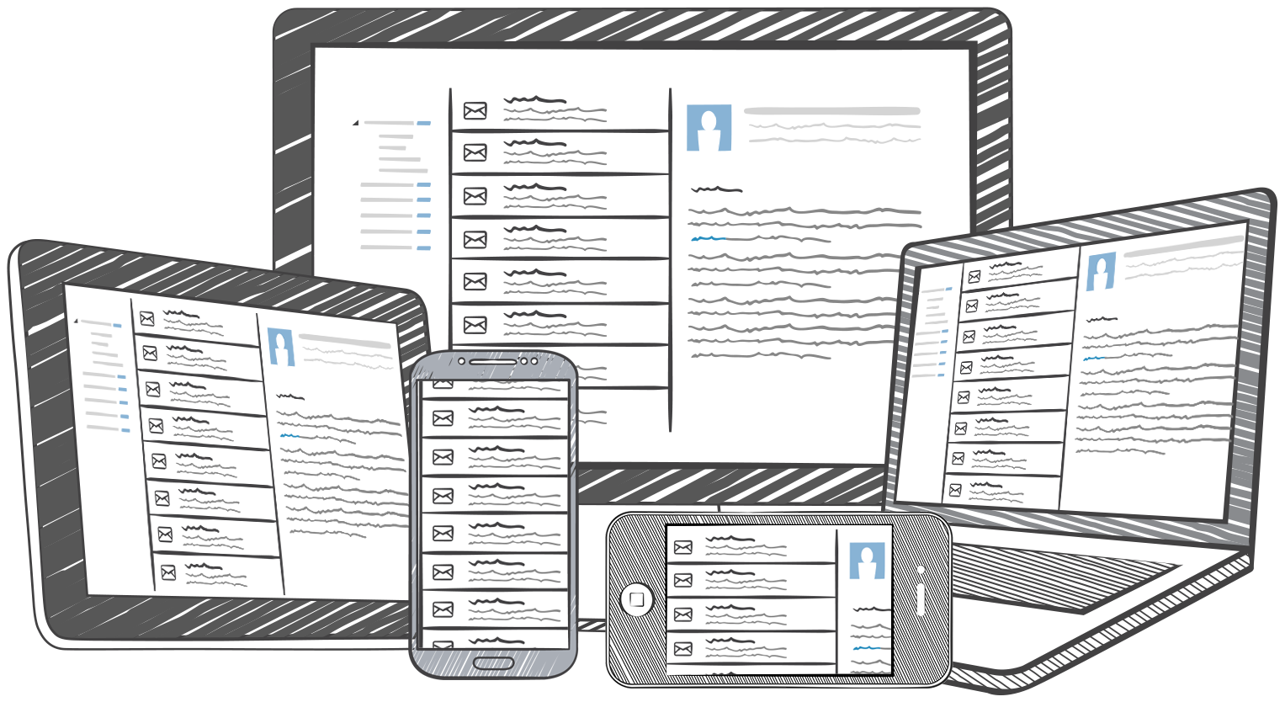

Today’s “Cloud Native” Applications
Deployed and managed, automatically
Cost aware
Globally distributed
Composed and orchestrated
Encrypted,
end to end
Content follows
you across devices

Slide 34
Sync state and data across devices, offline access, customer identity and login
Continual improvement based on customer usage
Building feature-rich, engaging apps is “increasingly reliant” on “back end” services
Safeguard customer data and credentials, Interact with broad set of AWS services
Notes:
Intro
Marco Argenti
VP,
AWS Mobile

Slide 35



Overcome the Challenge of Multiple Devices
Amazon Cognito
Fully managed user identity and data synchronization service
Manage unique identities & support multiple login providers
Seamlessly sync across devices & work offline via local data store
Safeguard AWS credentials
Identity
Synchronization
Security
+
+
Notes:
Amazon Cognito is a fully managed user identity and synchronization service, which has three components: identity, synchronization and a robust set of security features. These three components allow you to sync user preferences, resume game state across devices, securely access other AWS services from your mobile app, and offer that important anonymous guest access.

Slide 36
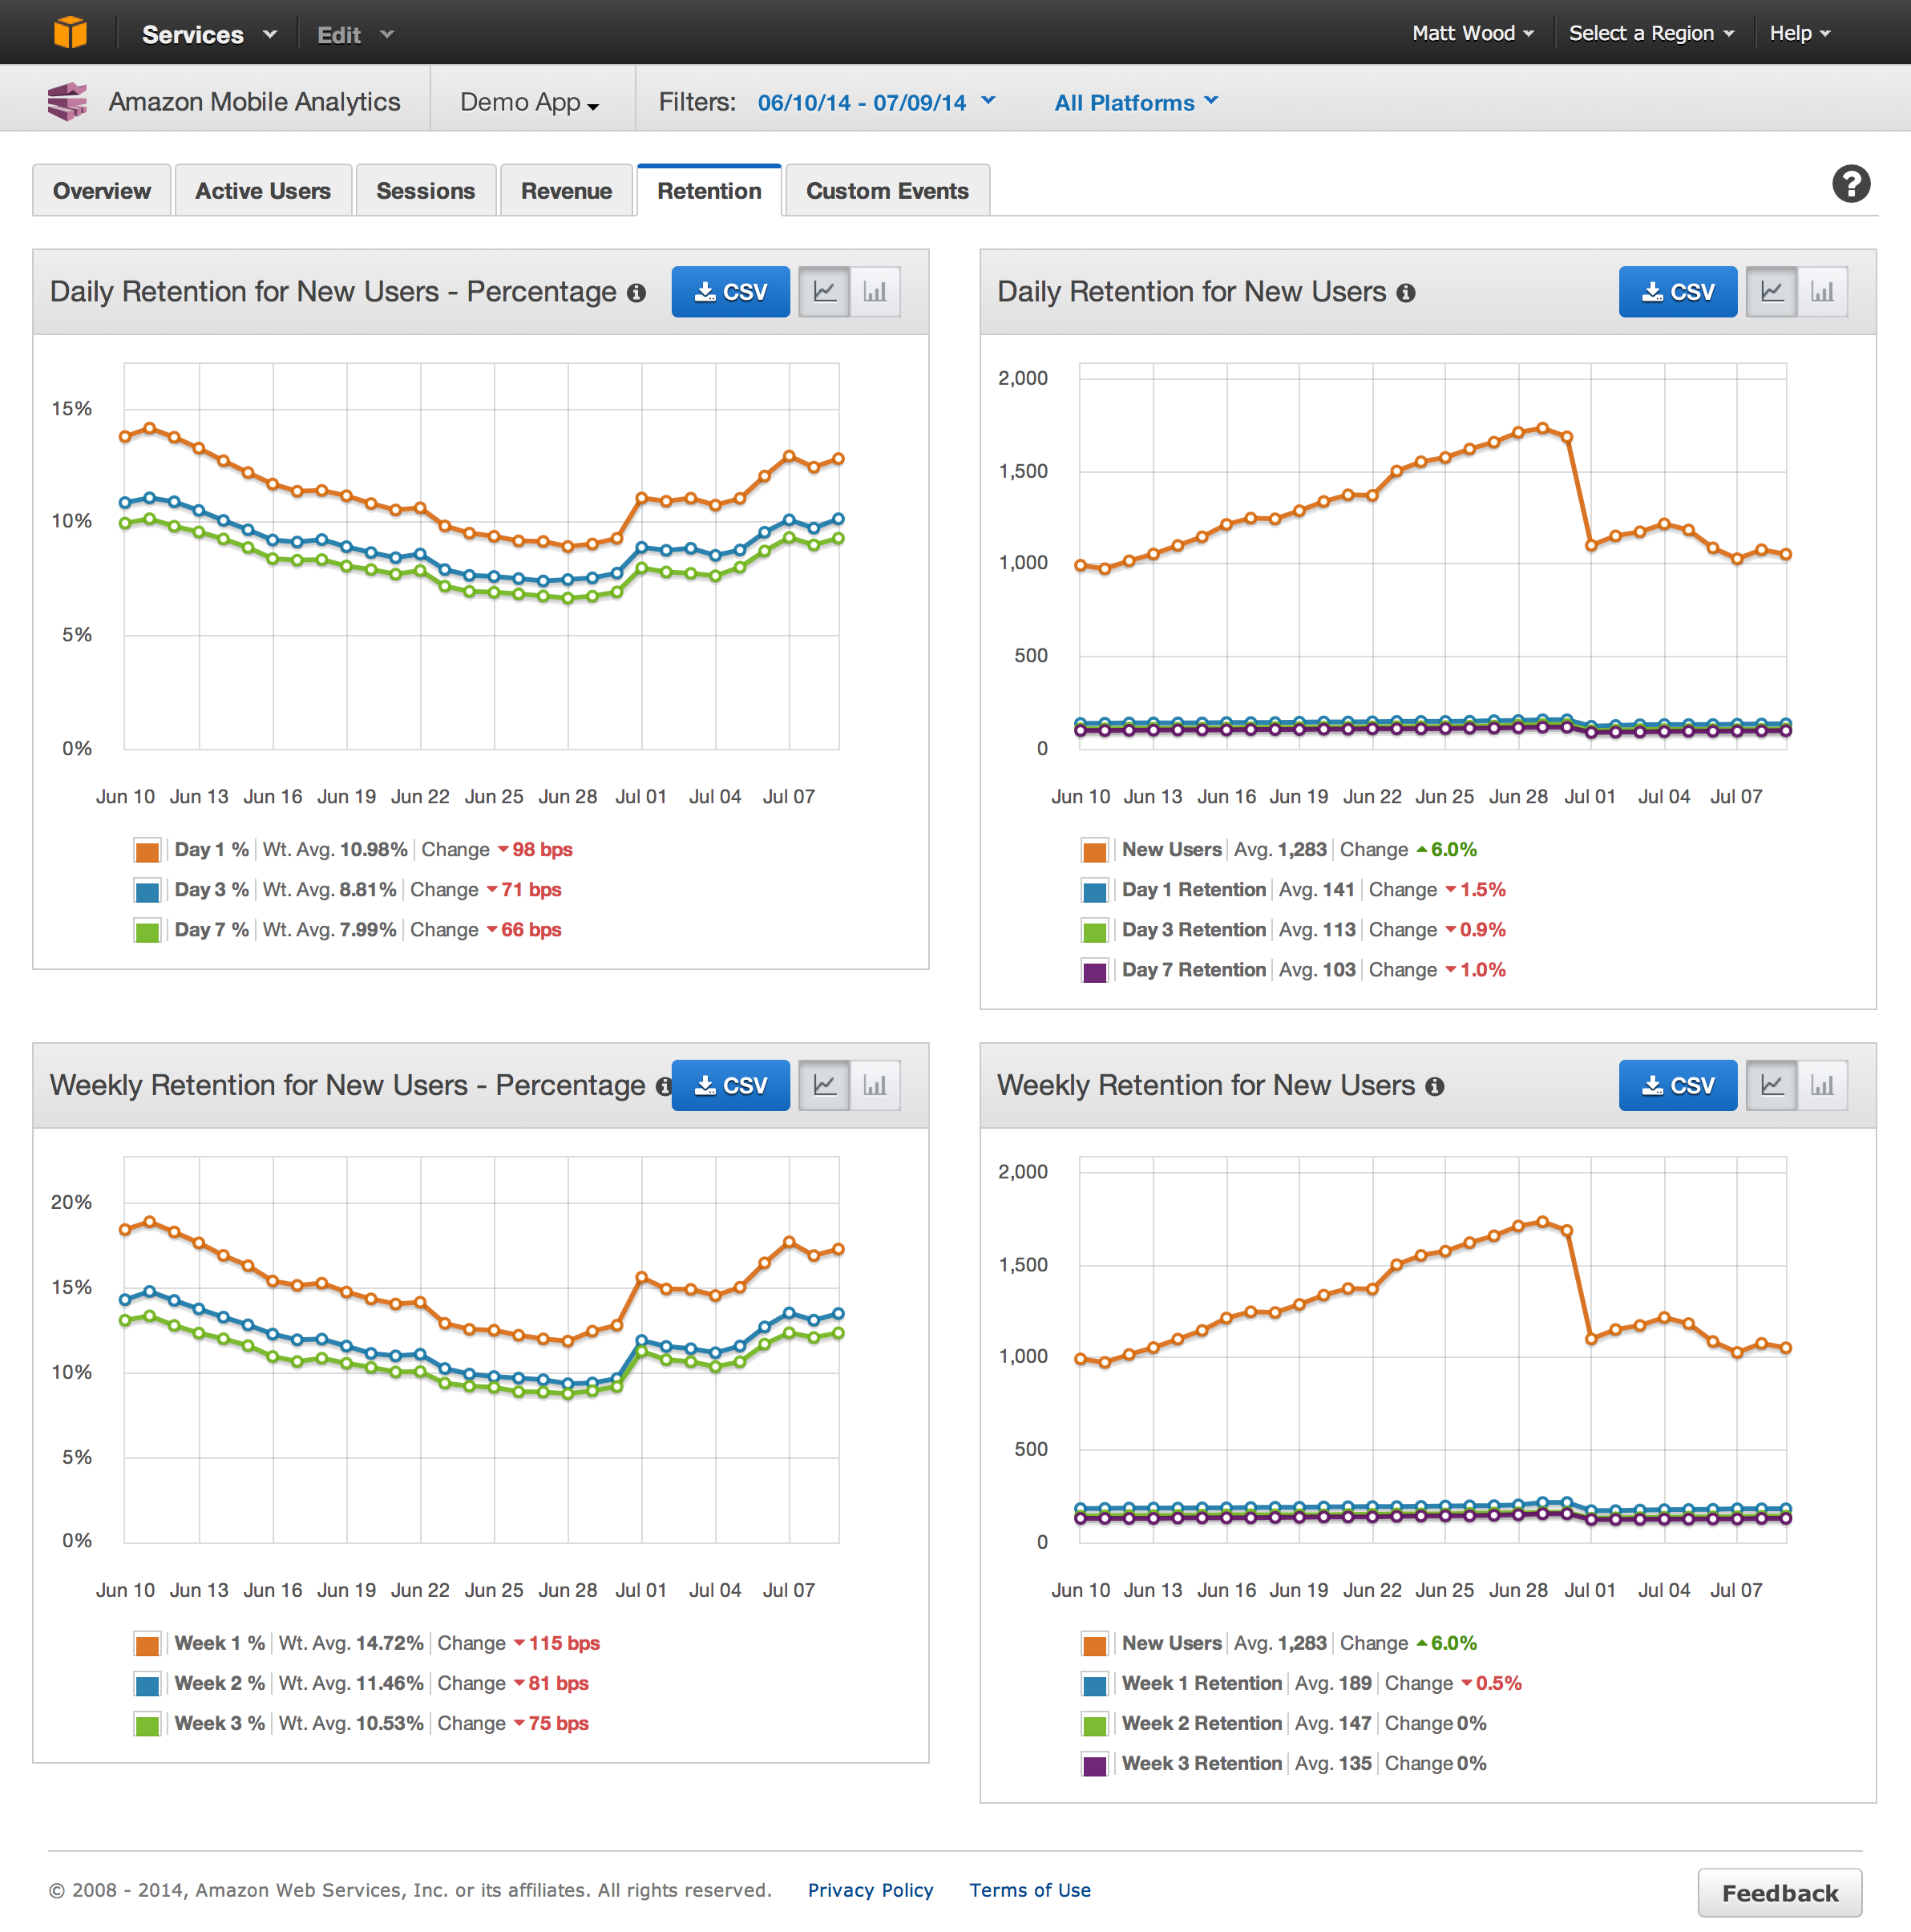
Fast, Reliable, User Engagement Metrics
Amazon Mobile Analytics
Fast: get your data within an hour
Automatic MAU, DAU, session and retention reports
Design and track custom app events
Data is not mined or sold by Amazon
Notes:
allows you to stay up to speed with how your own customers are using your app, with data available with an hour. It includes automatic monthly active user and daily active user metrics, along with session and retention reports. You can also design and track custom app events to extend you metrics in a way which makes most sense for your application. And finally, your retain ownership over your data, which is not mined or sold by Amazon.

Slide 37


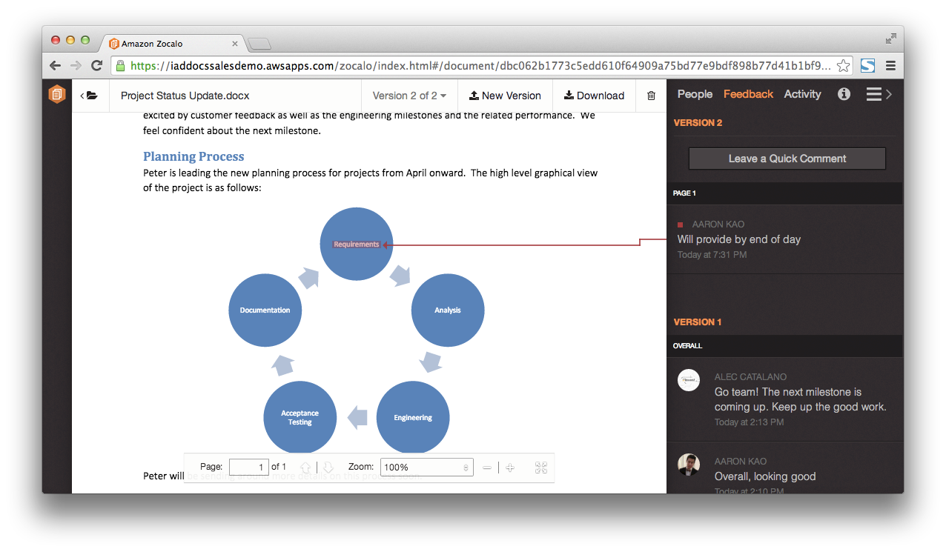





Document Sharing and Collaboration – The Next Enterprise IT Problem AWS is Solving
Amazon Zocalo
Fully managed, secure document storage and sharing
Simple document feedback
Access from any device
Secure and reliable
Integrate your corporate directory
Integrate your
corporate directory
Easy sharing
Simple document
feedback
Access from
any device
Secure
Low cost

Slide 38
AWS Introduction
Why are enterprises choosing AWS?
What are enterprises using AWS for?
How are enterprise getting started with AWS?

Slide 39


Strategy 1: Cloud for Development & Test Environments
SAP
Oracle Enterprise Applications
SAP
Reduced deployment time from weeks to days
Reduced test environment costs
70% reduction in operational costs
Notes:
Oracle = Tokyo Stock Exchange
The Tokyo Stock Exchange is using Amazon EC2 and Amazon VPC in the AWS Tokyo Region as a cost effective test environment to run Oracle's Enterprise Manager 11g IT management package for verification and service monitoring.
SAP = Lionsgate
Lionsgate, a $2 billion global entertainment corporation, currently uses AWS for production Microsoft SharePoint and SAP development and test resulting in significant cost savings and reduced application deployment time from weeks to days.
SAP = Galata Chemicals
Galata Chemicals, an additives producer based in Connecticut, wanted to lower IT costs while maintaining a disaster recovery solution for their SAP ERP system. Galata worked with Protera Technologies to move Galata’s disaster recovery solution to AWS, saving time and reducing operational costs by approximately 70% when compared to an on-premises solution.

Slide 40













Strategy 2: Build New Apps in the Cloud
Faster to build
Easier to manage
Less expensive to run
Distributed architectures for high availability
Financial record archiving
Global deals engine
Product Prototyping & Design
Hotel booking engine
Video streaming
App streaming
Firmware upgrades
Clinical trial simulations
Global web properties
Audience management & creative design
Biological data research
SIM card credit
News distribution
Mobile games
Notes:
Oracle = Tokyo Stock Exchange
The Tokyo Stock Exchange is using Amazon EC2 and Amazon VPC in the AWS Tokyo Region as a cost effective test environment to run Oracle's Enterprise Manager 11g IT management package for verification and service monitoring.
SAP = Lionsgate
Lionsgate, a $2 billion global entertainment corporation, currently uses AWS for production Microsoft SharePoint and SAP development and test resulting in significant cost savings and reduced application deployment time from weeks to days.
SAP = Galata Chemicals
Galata Chemicals, an additives producer based in Connecticut, wanted to lower IT costs while maintaining a disaster recovery solution for their SAP ERP system. Galata worked with Protera Technologies to move Galata’s disaster recovery solution to AWS, saving time and reducing operational costs by approximately 70% when compared to an on-premises solution.

Slide 41




Strategy 3: Use Cloud to Make On-Premises Apps Better
App 1
Elastic Map Reduce
App 2
Analytics
App 3
Amazon Redshift
…
AWS Storage Gateway
Backup
Corporate Data Centers
Amazon S3
App N

Slide 42

Strategy 3: Use Cloud to Make On-Premises Apps Better
Big Data Analytics
Big Data Analytics
Export operational data to AWS for analytics processing
50% cost reduction with 2x faster queries using Amazon Redshift

Slide 43



Strategy 4: Cloud Apps that Integrate with On-Premises Apps
AWS serves application content & data
Hybrid App
Integration to Samsung data centers for financial transactions
On-Premises Data Centers

Slide 44



Strategy 5: Migrate Existing Apps to the Cloud
1/3 of servers migrated to AWS
Migrated 500 web properties in 5 months
Migrated clinical trials simulations platform
App
Saved £1.5 Million
New product web sites live in 2 days vs. 2 weeks
Simulations in 1.2hrs vs. 60hrs
64% reduction in costs
On-Premises Data Centers

Slide 45


Strategy 6: All In
100s of applications supporting 33M+ global members
10,000s of EC2 instances in multiple regions & zones
At peak consumes 1/3 of US Internet bandwidth

Slide 46

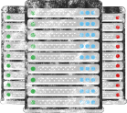




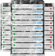

Spotlight Customer: DowJones News Intl
From over 40 data centers down to 6
Planning to migrate 3000 Apps by January 2015; Saving 100M over 3 Years
Evaluate infrastructure
Make business case
Move to the cloud
VS
Notes:
no script

Slide 47
Engage with us if…
You’re facing a tech refresh in the next year
You need to add capacity for growing workloads
You have a new application project
You plan to launch a technology driven business initiative
You’re considering outsourcing part or all of your IT environment
You’re outsourced and aren’t getting the results you want

